Slide 1
Introduction to Middle School Admissions

Slide 2
Overview
September - November | Middle School Open Houses Contact each school directly to learn when to visit.
December 1 | Middle School Applications Due
March | New Schools Round If there are new schools in the district, you may apply to new programs you are interested in.
April | Notification Letters Distributed
May | Appeals You may submit an appeal to your guidance counselor. You may appeal to up to three schools for any reason.

Slide 3
Changes for 2018
Online application | You will not receive a paper application. You will be provide with passwords and guidelines.
Blind Ranking | Starting this fall, no middle schools – including those in Districts 1, 2, and 3 – will be able to see how applicants ranked them. This means: Families should rank schools in their true order of preference. Families may add additional choices to their application, and not dilute their chance of matching with a top choice.

Slide 4
Middle School Application
YOUR CHILD
All schools to which your child may apply will be listed on your child’s online application.
Receive personalized MS Application login information from school.
Optional Step:
New Schools Round: If new programs are opening, eligible students may apply in March.
November
Complete application by ranking up to 12 programs in order of preference.
December 1
Students will be notified (method pending) with their middle school match; students who were accepted into a new schools program may have two matches.
April
1 Match

Slide 5
What schools will be on my application?
All schools that your child may apply to, including the following:
Your Zoned School* *not all students have a zoned middle school Learn if you have a zoned middle school at schools.nyc.gov/ schoolsearch | District Schools If your child lives and goes to school in different districts, your child may apply to middle schools in both districts. | Boroughwide Schools | Citywide Schools
What schools will NOT be on my application?
School-Based Application Schools | Charter Schools
Contact these schools directly to learn how to apply.

Slide 6
Middle School Programs
You can think of programs as “doorways” through which schools accept students.
If a school has multiple programs, students may apply to one program, or more than one program at that school.
Programs at the same school may have different Admissions Priorities and Methods. You may choose to apply to a particular program at a school because of how it does its admissions or because it has a particular theme.
Program #1
Program #2

Slide 7
The Application: Receive and Review
What to review:
Student Information: Make sure all information, including address, is correct.
Zoned Middle School: See if your child has a zoned middle school. Look up this school in the directory to learn how being in the zone affects admissions.
Academic Information: These will affect admissions to some programs.
Tip: Not every student has a zoned middle school.

Slide 8
The Application: How to Complete It
Families should rank programs in order starting with the one they most want to attend. Do this by writing the number “1” next to you top choice and continuing. Families may rank up to 12 programs.
Once you have ranked programs, submit application online by December 1.
Tip: After ranking your favorite programs, rank other programs you’d prefer over your least favorite programs. Remember, if you do not match to a program you’ve ranked, you will be matched to a program with availability in your district.

Slide 9
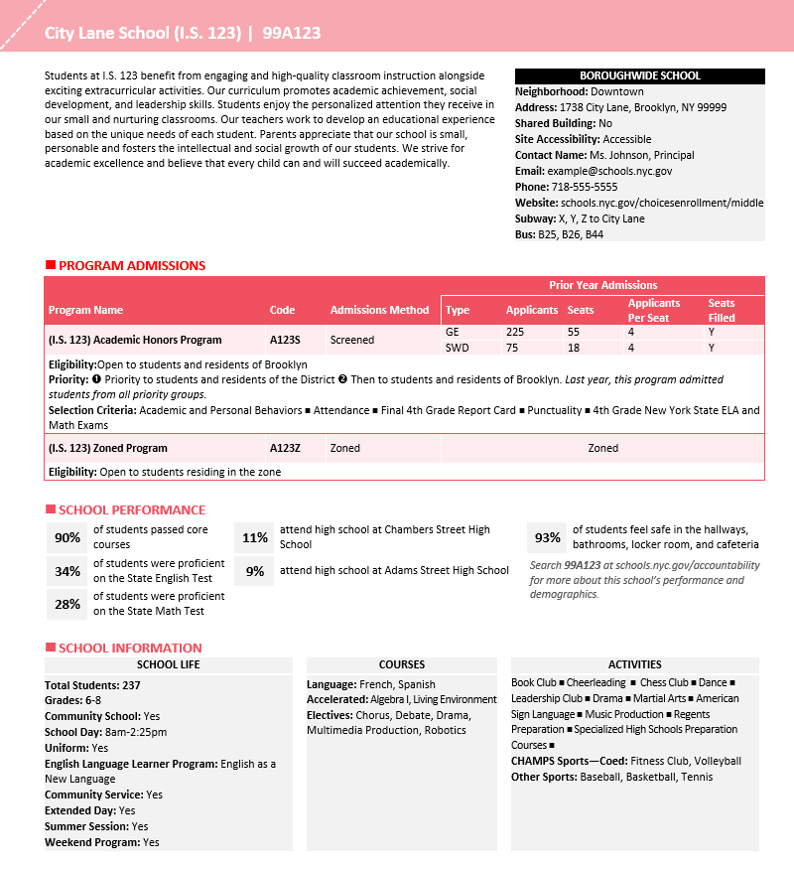
A good application lists programs
of interest to your child.
Use the MS Directory as a starting point. When exploring, think about…
location
School performance
COURSES
size
Activities
6 of 9

Slide 10
How is my match determined?
Student Factors
Program Factors
Choices on Application
Admissions Priorities
The order in which applicants are considered.
The programs ranked on the application AND the order in which they are ranked.
Admissions Methods
Match!
How programs consider and match with applicants.
Student Information (For some programs)
Student’s academic record and/or address.
Seat Availability
The number of seats available for applicants.

Slide 11
How is my match determined?
Admission Priorities
Admissions Priorities determine the order that applicants are considered for placement.
This means that students are considered in groups. All students in the first priority group will be considered first. If seats are available, students in the second priority group will be considered next.
If your child does not fall into any of the priority groups, he/she is not eligible to apply. Remember: there is no sibling priority in Middle School Admissions.
Admissions Priorities: ❶ Priority to students and residents of the District ❷ Then to students and residents of Brooklyn.
Means that
All students who live or go to school in the District that list this program on their application will be considered before other Brooklyn students who list this program on their application.

Slide 12
How is my match determined?
Admission Methods that DO NOT see applicants’ academic information
An Admissions Method is the way a school program considers and matches with applicants. Remember that students are first grouped by Admission Priority and then evaluated by Admission Method.
Zoned Based on address. | Unscreened Random selection. | Limited Unscreened Random selection, but students will move into a higher priority group by signing in at a school event. | Talent Testing Based on student’s exam performance in specified talent areas.
Tip: If applying to a “Limited Unscreened” program, visit and sign in!

Slide 13
How is my match determined?
Admission Methods that DO see applicants’ academic information
An Admissions Method is the way a school program considers and matches with applicants. Remember that students are first grouped by Admission Priority and then evaluated by Admission Method
Screened School ranks students based on 4th grade attendance, behavior, state tests, & grades. Other requirements may exist (i.e.testing, interview) | Composite Score Students are admitted based on a score that’s calculated using fourth grade report cards, state ELA and math exams, attendance, and behavior. See published rubrics. | Screened for Language Based on students’ English language skills.
Tip: Before ranking a program on your application, please check all details about that program’s admissions in the MS Directory!

Slide 14
How is my match determined?
Seat Availability
To learn about how competitive a program is, review the number of available seats in a program, and the number of applicants for those seats.
Program with Lower Demand
2015 Seats | 2015 Applicants
150 | 250
Program with Higher Demand
2015 Seats | 2015 Applicants
150 | 1,170
Tip: Don’t only rank programs that have high demand.

Slide 15
How is my match determined?
Special Education
ICT
SETSS
Related Services – OT, PT, S/L, Counseling
Testing Accommodations
Middle School Directory for previous year’s statistics (Students with Disabilities)

Slide 16
Things To Note
There is no Sibling Preference with Middle School
This also applies for twins applying to the same schools.
Many schools allow only one guardian to attend tours with their child.
Many tours sell out VERY quickly, so you need to be vigilant with setting up tours as soon as the dates are released.
It is imperative that you confirm all student data with school – we need accurate street address, email address and phone number. Try to do this before the last day of school.
If you plan on moving before the Fall or during 5th Grade, please notify us immediately.
We are so lucky to be in District 2!! The middle schools are GREAT.

